Slide 1
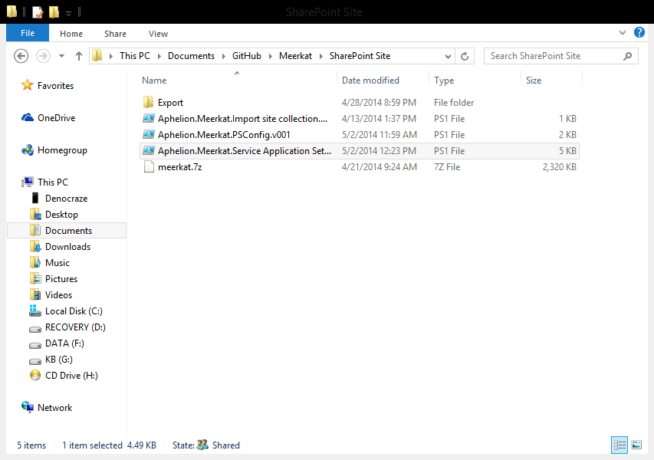
You can either run the script directly from windows powerhell ISE or run it from powershell. Values will be prompted for at run time.

Slide 2
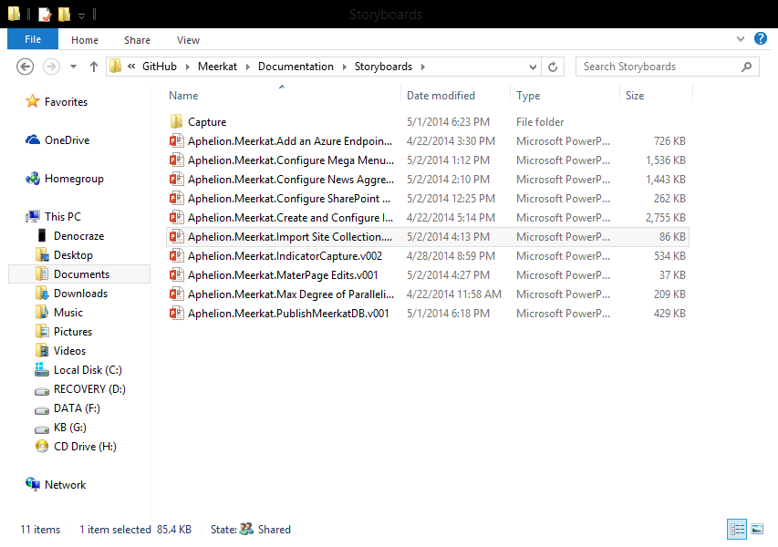
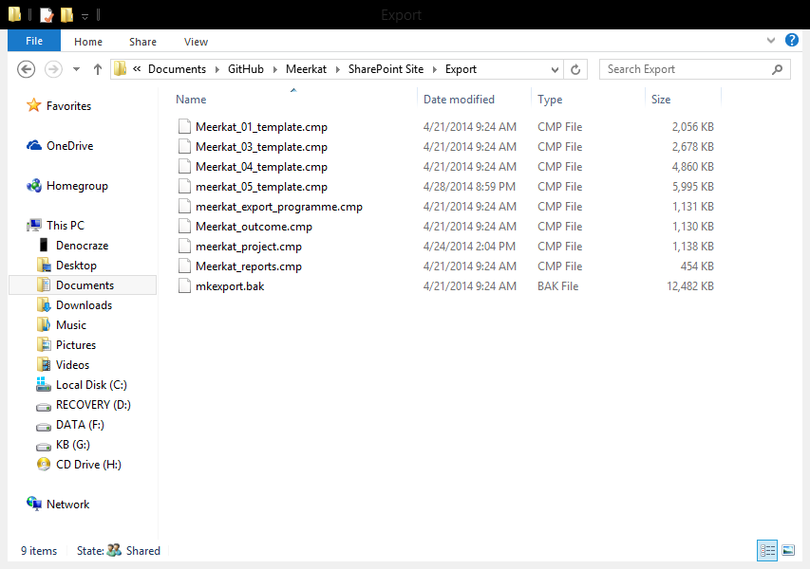
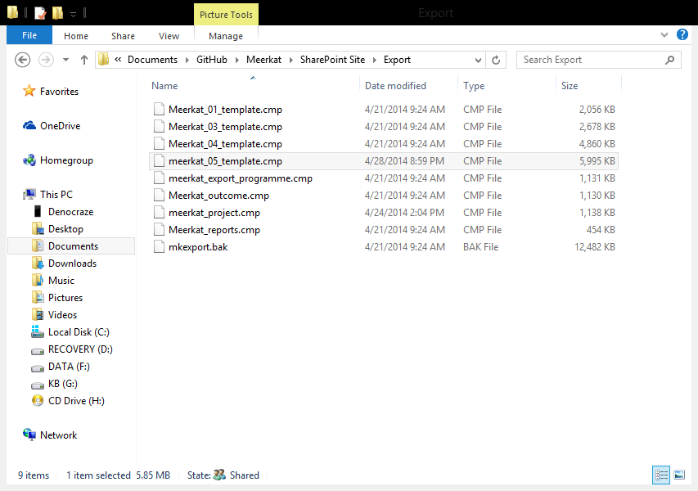
Navigate to the Export folder and locate the file you will be using for the export. You’ll be prompted for the full path of the import file when the script runs. You should use Meerkat_05_template.cmp for this import.

